Slide 1




Excel
Training
for Beginners
SAID FAWZY
Manager of Information Center
Tendering Department
Arab Contractors

Slide 2


Excel
Training
for Beginners
SAID FAWZY
7
Inserting Objects

Slide 3






90%
90%
Inserting and Formatting Pictures
Adding Shapes and Text Boxes
Using Icons and 3D Models
Creating Diagrams with SmartArt
Inserting Screenshots

Slide 4
90%
90%
Adding Comments and Notes
Exam 7: Inserting Objects

Slide 5
Excel
Training
for Beginners
SAID FAWZY
Inserting and Formatting Pictures
1

Slide 6
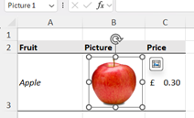
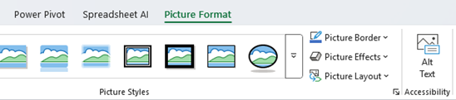
Inserting and Formatting Pictures
Pictures

Slide 7
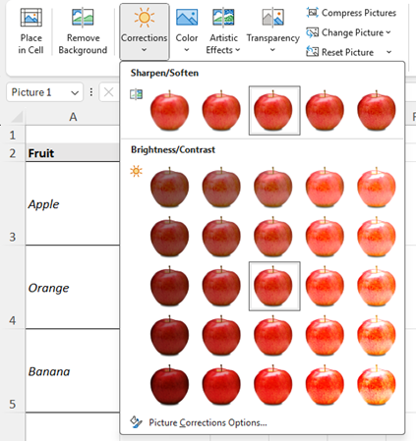
Adjust Group
Corrections

Slide 8
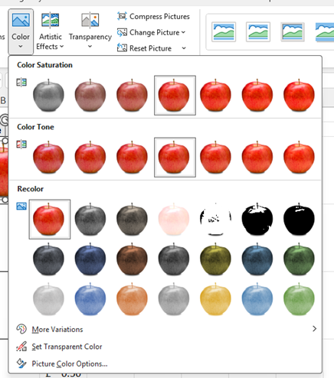
Adjust Group
Color

Slide 9
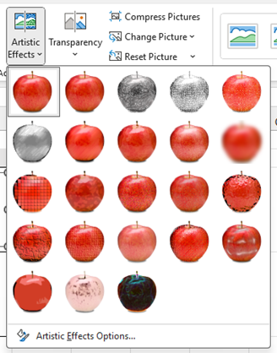
Adjust Group
Artistic Effects

Slide 10
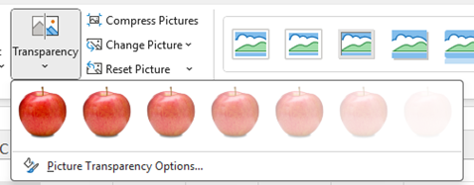
Adjust Group
Transparency

Slide 11

Adjust Group
Picture Styles

Slide 12
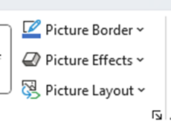
Adjust Group
Other Options

Slide 13
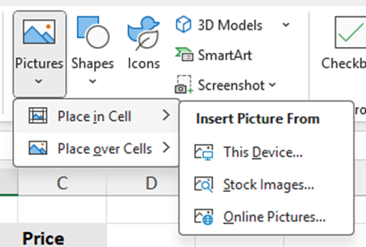
Insert Picture
Insert Picture From Options

Slide 14

Insert Picture
Insert Options

Slide 15
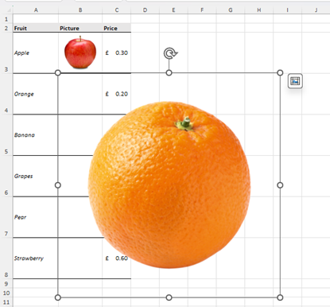

Insert Picture
Resize and Rotate

Slide 16
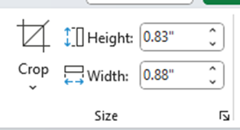
Insert Picture
Picture Size

Slide 17
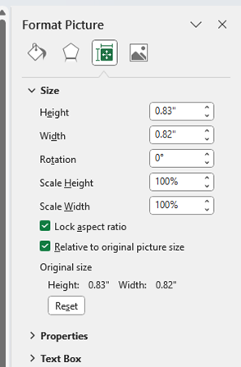
Insert Picture
Lock Aspect Ratio

Slide 18
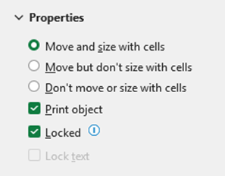
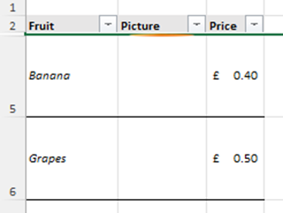
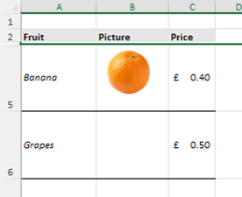
Insert Picture
Move and size with cells

Slide 19

Insert Picture
Insert from Stock Images

Slide 20
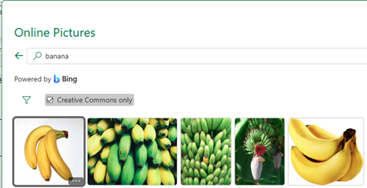

Insert Picture
Online Pictures

Slide 21
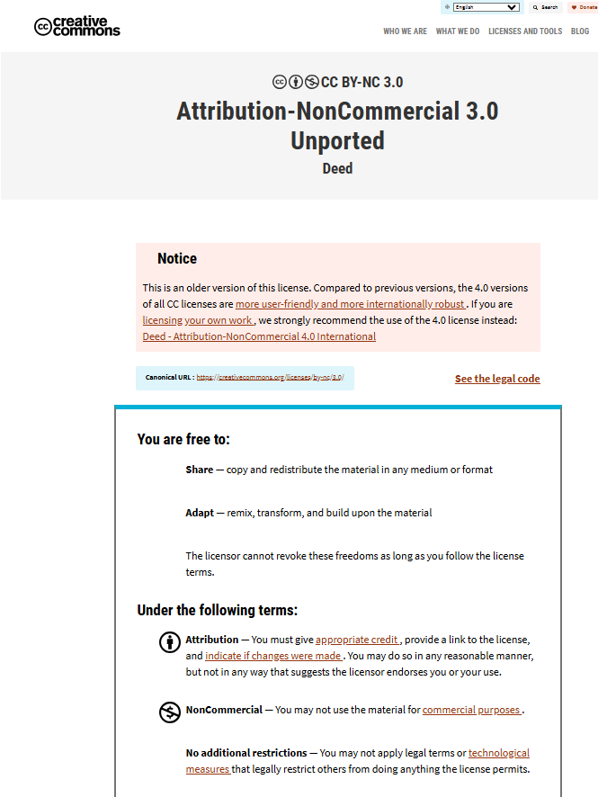
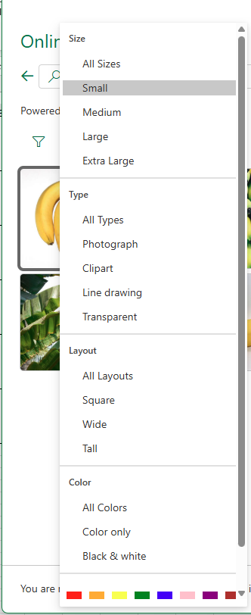

Insert Picture
Online Pictures

Slide 22
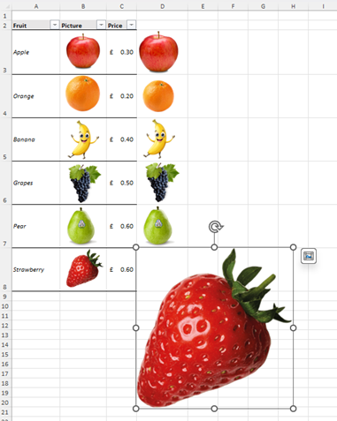
Insert Picture
Place in Cell

Slide 23
Excel
Training
for Beginners
SAID FAWZY
Adding Shapes and
Text Boxes
2

Slide 24
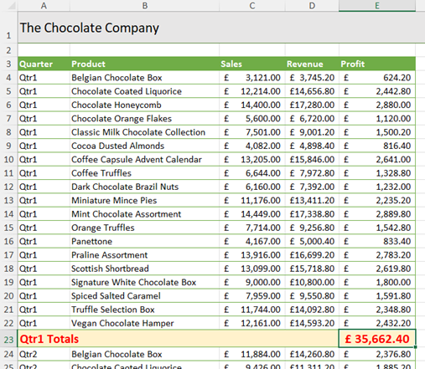
Adding Shapes and Text Boxes

Slide 25
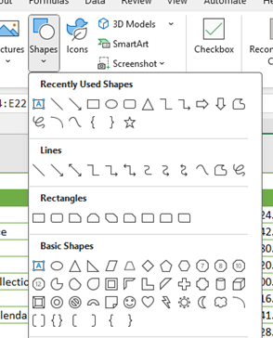
Adding Shapes and Text Boxes
Shapes Gallery

Slide 26

Adding Shapes and Text Boxes
Cutout people

Slide 27
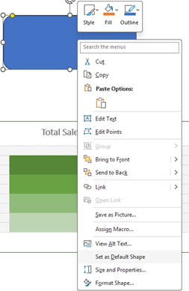
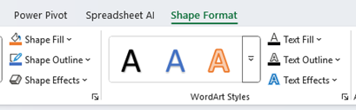
Adding Shapes and Text Boxes
Set Default Format for a Shape

Slide 28
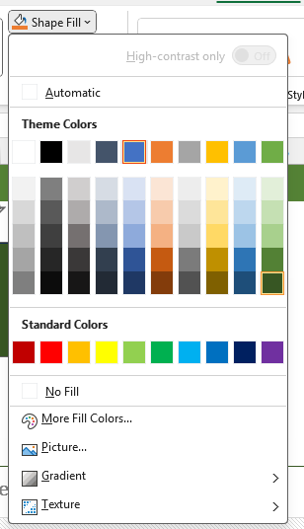
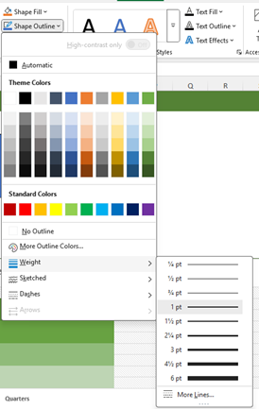
Adding Shapes and Text Boxes
Shape Fill and Border

Slide 29


Adding Shapes and Text Boxes
Duplicate an Object

Slide 30
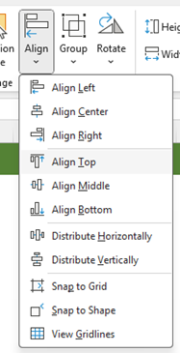
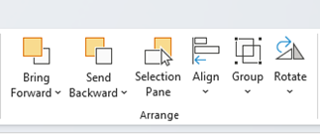
Adding Shapes and Text Boxes
Align Shapes

Slide 31
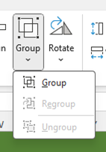
Adding Shapes and Text Boxes
Group and Ungroup Shapes

Slide 32
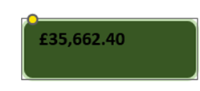


Adding Shapes and Text Boxes
Link the Shape to Cell Value

Slide 33

Adding Shapes and Text Boxes
Format Text in the Shapes

Slide 34
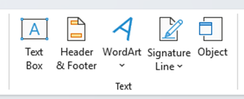
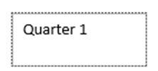
Adding Shapes and Text Boxes
Insert Textbox

Slide 35
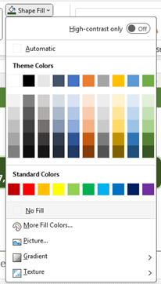
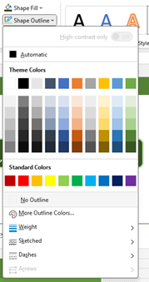
Adding Shapes and Text Boxes
Remove out the outline and background

Slide 36

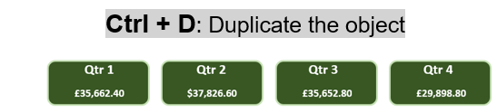
Adding Shapes and Text Boxes
Textbox and Shapes

Slide 37
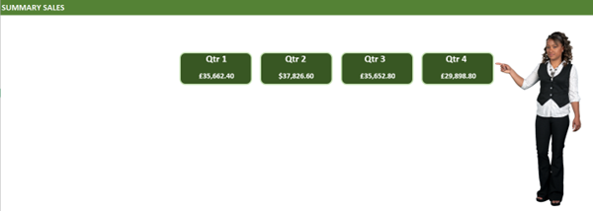
Adding Shapes and Text Boxes
Textbox , Shapes and Cutout People

Slide 38
Excel
Training
for Beginners
SAID FAWZY
Using Icons and 3D Models
3

Slide 39
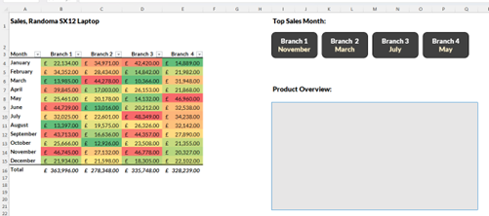
Using Icons and 3D Models

Slide 40
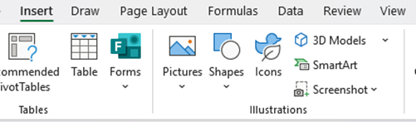
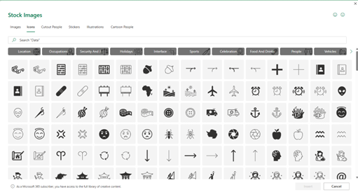
Using Icons and 3D Models
Insert Icon

Slide 41
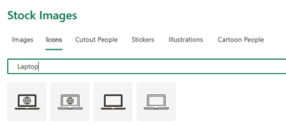

Using Icons and 3D Models
Insert Icon

Slide 42

Using Icons and 3D Models
Insert Icon

Slide 43
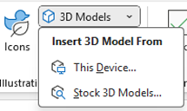
Using Icons and 3D Models
Insert 3D Model

Slide 44
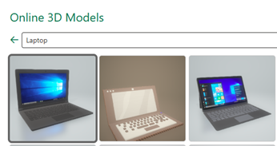
Using Icons and 3D Models
Stock 3D Models

Slide 45
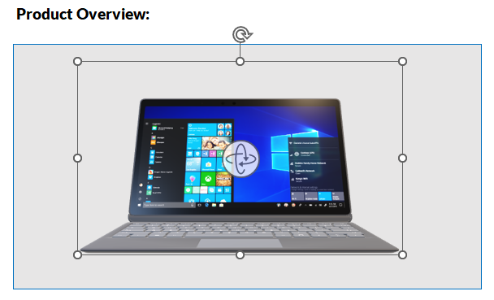
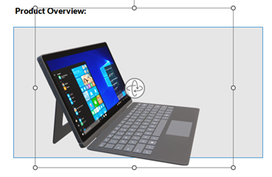
Using Icons and 3D Models
Stock 3D Models

Slide 46
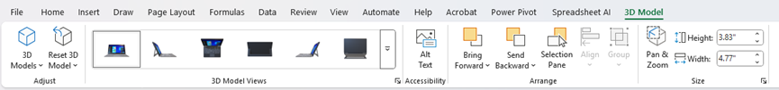

Using Icons and 3D Models
Stock 3D Models

Slide 47
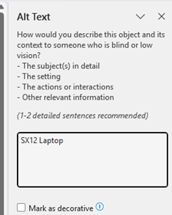

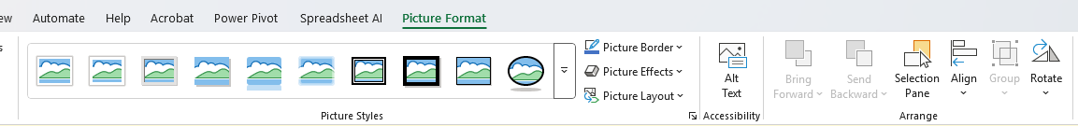
Using Icons and 3D Models
Add Alt Text for Accessibility

Slide 48
Excel
Training
for Beginners
SAID FAWZY
4
Creating Diagrams with SmartArt

Slide 49
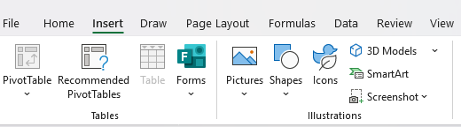
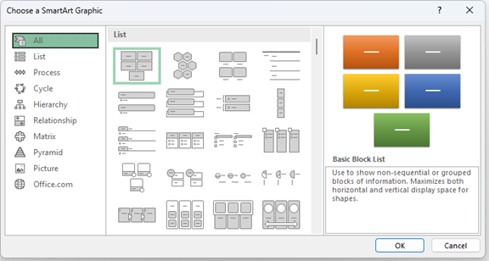
Creating Diagrams with SmartArt
Create a Process Flow Chart

Slide 50
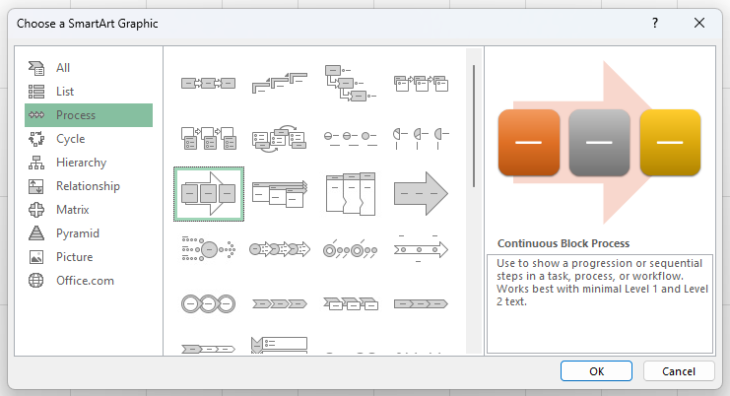
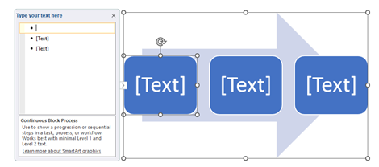
Creating Diagrams with SmartArt
Process - Continues Block Process

Slide 51
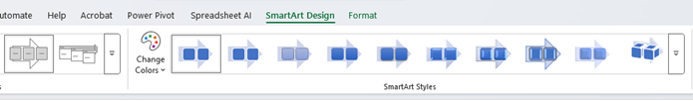
Creating Diagrams with SmartArt
Process - Continues Block Process

Slide 52

Creating Diagrams with SmartArt
Add Text

Slide 53


Creating Diagrams with SmartArt
Add Shapes

Slide 54


Creating Diagrams with SmartArt
Format your Chart

Slide 55


Creating Diagrams with SmartArt
Create a Hierarchy Chart

Slide 56


Creating Diagrams with SmartArt
Insert Pictures to the Diagram

Slide 57


Creating Diagrams with SmartArt
Edit Pictures

Slide 58


Creating Diagrams with SmartArt
Edit Pictures

Slide 59

Creating Diagrams with SmartArt
Create a Hierarchy Chart

Slide 60


Creating Diagrams with SmartArt
Add a shape

Slide 61
Excel
Training
for Beginners
SAID FAWZY
5
Inserting Screenshots

Slide 62

Inserting Screenshots
Screenshot

Slide 63

Inserting Screenshots
Screenshot

Slide 64


Inserting Screenshots
Screen Clipping

Slide 65
Excel
Training
for Beginners
SAID FAWZY
Adding Comments and Notes
6

Slide 66

Adding Comments and Notes

Slide 67

Adding Comments and Notes
Add a Comments and Notes

Slide 68

Adding Comments and Notes
Add a Comment

Slide 69



Adding Comments and Notes
Insert Note

Slide 70

Adding Comments and Notes
Control Comments and Note Display

Slide 71

Adding Comments and Notes
Control Comments and Note Display

Slide 72

Adding Comments and Notes
Control Comments and Note Display

Slide 73

Adding Comments and Notes
Convert Notes to Comments

Slide 74

Adding Comments and Notes
Navigate Comments

Slide 75

Adding Comments and Notes
Show Comments

Slide 76


Adding Comments and Notes
Using the Context Menu

Slide 77


Adding Comments and Notes
Using the Context Menu

Slide 78
Excel
Training
for Beginners
SAID FAWZY
Exam 7
Inserting Objects

Slide 79

Exam 7: Inserting Objects

Slide 80

Exam 7: Inserting Objects

Slide 81

Exam 7: Inserting Objects

Slide 82

Exam 7: Inserting Objects

Slide 83

Exam 7: Inserting Objects

Slide 84

Exam 7: Inserting Objects

Slide 85



